Slide 1
Chapter 11-13 Compiling C to Assembly – the Run-time Stack
计算机系统概论
Introduction to Computing Systems
（CS1002A.03）
苗付友
mfy@ustc.edu.cn 2024 Fall
计算机科学与技术学院
School of Computer Science and Technology

Slide 2
Outline
1
1
Review
Review
2
2
From ENIAC to the Stored Program Computer
Assembly Language Overview
3
3
A Machine Structure：von Neumann Model
Assembly Process
4
4
Summary
Summary

Slide 3
Problem Transformation - levels of abstraction
How do user programs get executed?
Translation from C to Assembly
Scope of variables
Function calls
Recursion
Pointers & Arrays
Data Structures
Memory Allocation
Natural Language
Algorithm
Program
Machine Architecture
Micro-architecture
Logic Circuits
Devices

Slide 4
Programming Languages
Assembly language is low-level.
It exposes machine instructions and details of the ISA to the programmer.
It is ISA-specific.
It is useful when the programmer needs fine-grained control of instruction flow and memory usage.
A high-level language provides a computational abstraction that is machine-independent.
Symbolic names (variables) instead of registers and memory locations.
High-level operators: multiply, divide, shift, ...

Slide 5
Why use a High-Level Language? …our choice= C
Expressiveness: say more with less effort, closer to human-level thinking
 | AND R2,R2,#0
 | AND R3,R3,#0
 | LDR R0,R5,#-1 | ; b
 | BRz L3
 | BRp L1
 | NOT R3,R3
 | NOT R0,R0
L1 | ADD R0,R0,#1 LDR R1,R5,#-2 | ; c
 | BRz L3
 | BRp L2 NOT R3,R3
 | NOT R1,R1
L2 | ADD R1,R1,#1
 | ADD R2,R2,R0 | ; b * c
 | ADD R1,R1,#-1
 | BRp L2 ADD R3,R3,#0
 | BRp L3
 | NOT R2,R2
 | ADD R2,R2,#1
L3 | STR R2,R5,#0 | ; store to a
a = b * c;
C statement
Equivalent LC-3 code

Slide 6
The Evolution of Programming
Machine Assembly Language Language (binary)
C
Java Python Haskell What’s
Next??
Simula/C++/etc

Slide 7
Quick Note: Compilation vs. Interpretation
Different ways of translating high-level language
Interpretation (LISP, Java, Python, Matlab…)
interpreter = program that executes program statements (generally one line/command at a time)
Called a Virtual Machine
easy to debug, make changes, view intermediate results
Compilation (C, C++, Pascal,…)
translates statements into machine language
does not execute, but creates executable program
performs optimization over multiple statements
Example:
X = W+W
Y = X + X
Z= Y + Y
Interpretted language: 3 instructions
Compiler optimized code: 1 instruction Z = 8*W

Slide 8
Compiling a C Program
Entire mechanism is usually called the “compiler”
Preprocessor
macro substitution
conditional compilation
“source-level” transformations
output is still C
Compiler
generates object file
machine instructions
Linker
combine object files
(including libraries)
into executable image
C Source and Header Files
C Preprocessor
Compiler
Source Code Analysis
Symbol Table
Target Code Synthesis
Library
Object Files
Linker
Executable Image

Slide 9
Linking, Loading,…Makefiles
Linking: produce final executable program by combining other code (libraries) used by program
Dynamic Linking: instead of linking at compile time the linking is done at run-time
Multi-file development….Makefiles assist in this
Read tutorials on makefiles
Loader: load executable image generated by linker & execute
Part of Operating system
Memory management system does the actual mapping from user space to physical addresses
.ORIG x3000 refers to user space x3000

Slide 10
Compiler
Source Code Analysis….you will learn the theory/foundation behind this in Foundations of Computing course
“front end”: parses programs to identify its pieces
variables, expressions, statements, functions, etc.
depends on language (not on target machine)
Code Generation… we will cover it implicitly in this course
“back end”: generates machine code from analyzed source
may optimize machine code to make it run more efficiently
very dependent on target machine
We will play the role of the code generation component as we discuss how different C concepts are implemented in LC3
This is what the compiler backend does
Symbol Table
map between symbolic names and items
like assembler, but more kinds of information

Slide 11
A Simple C Program
#include <stdio.h> #define STOP 0
int scale=10;
int square(){ /* function square */{
int x,y; /* two local variables */
x = scale*scale;
return(x);}
/* Function: main */
/* Description: gets value and squares it */
main()
{ /* variable declarations */
int number, value, temp; /* three integer local variables */
/* prompt user for input */
printf("Enter a positive number: ");
scanf("%d", &value); /* read into value */
/* scale input and print */
number = value*square();
printf(”number is %d\n", number);
}

Slide 12
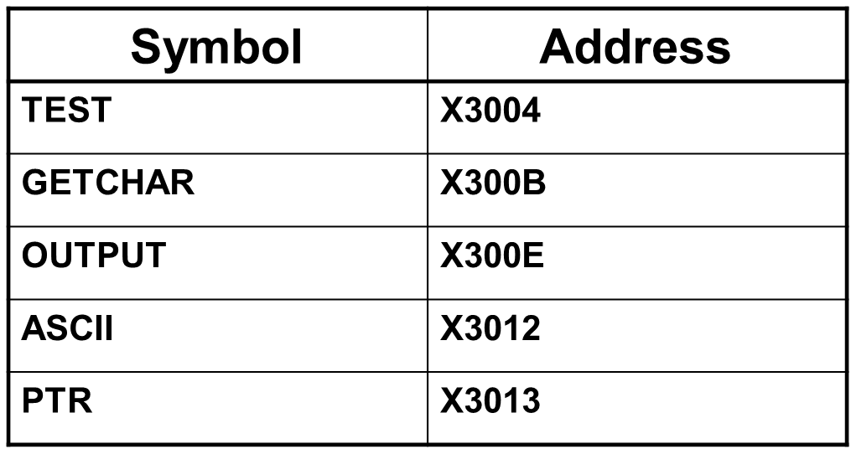
Symbol Table
Like assembler, compiler needs to know information associated with identifiers
in assembler, all identifiers were labels and information is address
Symbol table kept track of the addresses of the labels
Compiler keeps more information
Name (identifier)
Type
Location in memory
Scope
Name | Type | Offset | Scope
scale | int | 0 | global
number | int | 0 | main
value | int | -1 | main
temp | int | -2 | main
x | int | 0 | square
y | int | -1 | square

Slide 13
Implementing C: Translation from C to Assembly
Translate C to assembly
Translating operations is the easy part
Y = A*B is: MULT R3, R1, R2
Implement concept of scope
Concept of storage class
Static, Auto, Register….
Pointers
Function calls
Passing arguments to functions
…HOW ?
Starting point (Today): How are C variables allocated to memory ?....Run-time Stack

Slide 14
Translation: Allocation of Variables
What is compiler's task?
Allocate memory for variables in a systematic way.
Will build a symbol table to keep track of variable type,
size, location.
Generate instruction sequences that carry out the computations specified by operators and statements.
For this class, we will compile "by hand" to get a sense of how these translations occur.

Slide 15
Start point for translation:
Concept of Scope of Variable
In assembly, who has access to a memory location/variable ?
In high level programs, who has access to a variable ?
Concept of Scope of a variable
So how do we make this happen in assembly ???

Slide 16
Lessons from Example 1 (inclassC-1.c )
1,2,3. Concept of scope
Global and local
Code block ( enclosed in { } ) defines a scope block (Useful for placing debugging statements)
Prints:
Question1: Global= 0 Local = 1 x= 4
Question2: Global= 4 Local = 2 x=10
Question 3: Global= 4 Local = 1 x=10
4. Compound conditional statements
False – odd behavior….because C does not support this
Evaluate (7 > x)=? first and then ? > 2 (boolean with constant)
5. for loop iteration variable
initialized to 4 so for loop is not executed – Question5 never printed
6. False: Post and pre increment operators
Pre x++: Access value and then increment
Therefore y = x = 4 and x= 4+1=5.
Post ++x: Increment and then read value
Therefore x= 5+1 and x= 6

Slide 17
Lessons from Example 1
7. Constants – computed at start and stays as a constant
CC=8 and x=7
8. concept of local variables and passing arguments by value to function
8a: x=7,y=0, i= something; 8b: x=7, y=30
Argument x passed to function is not changed in main
Local variable y in function foo1 different from y in main; y in main is return value
Local variable i not initialized, so prints some random number
9. foo2 first call prints x=10, y=20 (function then adds 30 to y)
10 foo2 second time prints x=10, y=50
Concept of static variable but local in scope – value of static persists
11. swap does not swap arguments in main!
Only swaps values in local variables
When functions are called, the values of the arguments are passed to the function and not ‘access’ to the variables/arguments themselves.
12. loop terminates...overflow leads to negative number...T_min

Slide 18
Defining a variable in C
Identifier: references to this translate to locations
Name of the variable
Example: itslocal
Type: gives us information on data representation and space needed
Type of variable such as int, float, char…
Example: int itslocal
Scope
Where can it be accessed
Example: global variable itsglobal
Storage Class
How does C compiler allocate the storage
Does value persist or not
Two main classes in C: Automatic and Static

Slide 19
Scope: Global and Local
Where is the variable accessible?
Global: accessed anywhere in program
Local: only accessible in a particular region
Compiler infers scope from where variable is declared
programmer doesn't have to explicitly state
Symbol Table constructs this information
Variable is local to the block in which it is declared
block defined by open and closed braces { }
can access variable declared in any "containing" block
Global variable is declared outside all blocks

Slide 20
Where can you put variables….?
Local variable inside a function
Lasts only while the function is running
Local variable inside a function
Value persists throughout the life of the program
persistance
Global variable visible to all functions within a file
Global variable visible in more than one file
Block scope – inside the block (defined by { } )

Slide 21
According to the C89 Standard...
There are 4 types of scope
Prototype Scope
Just applies to prototypes
File Scope
Declared outside any function
Function Scope
only applies to labels!!!
Block Scope
includes function parameters

Slide 22
Scope vs. Lifetime
Scope Lifetime
File Scope Life of program
Block Scope Life of block
Can be overridden with “static”

Slide 23
Memory
Many languages have fixed mappings between scopes and lifetimes
In C, we have the option to decide...
void foo(void) { int x;
static int a;
x = 42;
When the function goes away, x and its value go away since they were auto storage class (and placed on stack).
Setting a value into a static variable (e.g. a) means that the value is stored in a static area and will persist throughout the entire execution of the program

Slide 24
Storage Class: Automatic Variables
Local variable inside a function (lasts only while the function is running)
auto keyword (never used!)
Located on stack
Storage Class: AUTO

Slide 25
Static Variables (II)
static
Initialized to zero (like global)
Located in static area
Value persists !
Example: foo2 being called second time
Storage Class: STATIC

Slide 26
Static Variables (III)
Global variable visible in more than one file
Declared outside of any function in one file
Declared extern in other files (or functions/blocks)
Located in static area
Storage Class: STATIC

Slide 27
Confused?
int x;
static int y;
int main()
{
static int z; int w;
...
Static?
auto?

Slide 28
auto
int foo(int z)
{
int x;
...
if(x == z)
{
int y;
y = ...
auto variables (implicitly)

Slide 29
Static Initialization
void foo(void)
{
int x = 10;
static int y = 20;
printf(“x = %d y = %d\n”, x, y); y += 30;
}
What prints the first time foo is called?
What prints the second time?

Slide 30
Scope can be global within a file
These are different variables with Global scope within their respective files
static int i; static int i;
int main()
{
...
}
int foo(...)
{
...
}
int bar(...)
{
...
}
int baz(...)
{
...
}

Slide 31
Scope can be global across all files
int i;
extern int i;
void f() { extern int i;
...
...
}
These are the same variable!

Slide 32
Other goodies
register
Suggests to compiler that this variable should be kept in a register
Cannot get address of variable declared register
Not as important as it once was with modern compilers
volatile
Type qualifier
Tells compiler that value in this variable may change on its own!
Used in
shared memory applications
Memory mapped I/O
…

Slide 33
Storage Class Specifiers
register auto static
const
extern
volatile
Type Qualifiers
33

Slide 34
Allocation of Variables in Memory and enforcing Scoping rules
Simply assigning a memory location for each variable may not be enough to enforce scope
Need to look at a better scheme to allocate high level program variables to memory in the processor
Scope
Storage class
Allocate space to a variable

Slide 35
Mapping C variables to Memory:
Allocating variables in Memory
How to allocate memory
locations to variables
Enforce scope
Low Memory
High Memory
x0000
xFFFF

Slide 36
Compiling & Executing C programs: The Run-time Stack
THIS is the key….

Slide 37
Memory Representation
Our convention will be that "high-memory" will be on the bottom and "low-memory" on top.
drawings are not to scale
x0000
Low Memory
High Memory
xFFFF

Slide 38
Typical Arrangement
Normally the actual program code (executable instructions) is placed in low memory
Operating System and boot code usually in lowest mem area
x0000
Code
xFFFF

Slide 39
Typical Arrangement
Next we have an area for storage of constant data
x0000
Code
Constant Data
xFFFF

Slide 40
Typical Arrangement
Data that may be changed follows
x0000
Code
Constant Data
Alterable Data
xFFFF

Slide 41
Typical Arrangement
Code
Constant Data
Alterable Data
x0000
Static
These three items comprise what is considered the static area of memory. The static area details (size, what is where, etc.) are known at translation or compile time.
xFFFF

Slide 42
Typical Arrangement: Heap
Code
Constant Data
Alterable Data
Heap
x0000
Immediately above the static area the heap is located.
The heap can expand upward as the program dynamically requests additional storage space
malloc()
In most cases, the runtime environment manages the heap for the user
Static
xFFFF

Slide 43
Typical Arrangement: stack for local variables
Finally, the activation stack starts in high memory and can grow down as space is needed.
Items maintained in the stack include
Local variables
Function parameters
Return values
x0000
Code
Constant Data
Alterable Data
Heap
Stack
Static
xFFFF

Slide 44
auto variables
auto, short for automatic variables are those that exist on the stack. The auto keyword is not normally used.
Automatic means that space is allocated and deallocated on the stack automatically without the programmer having to do any special operations.
Code
Constant Data
Alterable Data
Heap
Stack
x0000
Static
Dynamic
xFFFF

Slide 45
Summary of Typical Arrangement
These items in the upper portion of the memory change* during execution of the program.
Thus they are called dynamic
Code
Constant Data
Alterable Data
Heap
Stack
x0000
Static
Dynamic
*Not just their value

Slide 46
Compiler Magic
The compiler has the job of converting your C program into assembly code
Thus it must convert the symbolic variable names into addresses
How does it keep track of what is where?
Keep track of scope
Storage class
Symbol table provides much of this information

Slide 47
Activation Records!!!
Two main areas (for now) in memory:
Global data section
Run-time stack
Local variables exist only during lifetime of function
De-allocated after function completes
How to define area of memory for a code block/function ?
......Activation Record
Also called Stack Frame
Local variables allocated in the activation record
Activation record is portion of run-time stack
Function can only access a valid portion of the stack
Should not access another functions activation records!
When function returns…POP the record
The local variables can no longer be accessed!

Slide 48
Symbol Table
For each variable keeps track of
Type
Scope
Location (as an offset)
Either in global area or local area
If in local area, then based on activation record
Other info (const, etc.)

Slide 49
Symbol Table
Like assembler, compiler needs to know information associated with identifiers
in assembler, all identifiers were labels and information is address
Symbol table kept track of the addresses of the labels
Compiler keeps more information
Name (identifier)
Type
Location in memory
Scope
Name | Type | Offset | Scope
scale | int | 0 | global
number | int | 0 | main
value | int | -1 | main
temp | int | -2 | main
x | int | 0 | square
y | int | -1 | square

Slide 50
Offset?
Assembly code written by a compiler usually looks a little different from assembly code written by hand
Registers are dedicated to point to key areas of memory
R4 is the Global Pointer
Points to start of global static area
Code
Constant Data
Alterable Data
Heap
Stack
x0000
R4
xFFFF

Slide 51
Keeping Track of auto variables
Stack pointer is obvious but the compiler writer needs more info...
Where is the activation stack frame?
Code
Constant Data
Alterable Data
Heap
Stack
x0000
R4
R6 is Top of Stack (TOS) pointer
R6
xFFFF

Slide 52
Why do we care?
We would like to know where a variable is throughout the execution of a function
But, wait you say, I can just reference the variable from the stack pointer
HA!
Code
Constant Data
Alterable Data
Heap
Stack
x0000
R4
R6
xFFFF

Slide 53
Can we use TOS
What do we need to keep track of?
int f(int a, int b) {
int c;
c = a + b;
return c;
}
int main() { int x;
int y = 4;
x = f(7, y);
printf("%d\n", x);
return 0;
}

Slide 54
Frame Pointer
The Frame Pointer designates a fixed spot in the activation stack which can be used as a reference throughout execution of the function.
Code
Constant Data
Alterable Data
Heap
Stack
x0000
R4
Note: Frame pointer also called dynamic link
Store Frame pointer in register….R5
Points to ‘start’ of set of local variables
R6
R5
xFFFF

Slide 55
LC3: Local Variable Storage
LC3: Local Variable Storage
Local variables are stored in an
activation record, for each code block also known as a stack frame.
Cannot afford to forget about the Stack ©
temp
value
number
Symbol table “offset” gives the distance from the base of the frame.
R5 is the frame pointer – holds address of the base of the current frame.
A new frame is pushed on the
run-time stack each time a block is entered.
Because stack grows downward,
base is the highest address of the frame, and variable offsets are <= 0.
R5

Slide 56
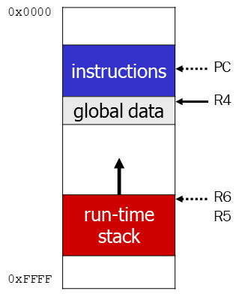
Summary: LC3 Allocation for Variables
Global data section
All global variables stored here (actually all static variables)
R4 points to beginning
Run-time stack
Used for local variables
R6 points to top of stack
R5 points to top frame on stack
New frame for each block
(goes away when block exited)
Offset = distance from beginning of storage area
Global: LDR R1, R4, #4
Local: LDR R2, R5, #-3

Slide 57
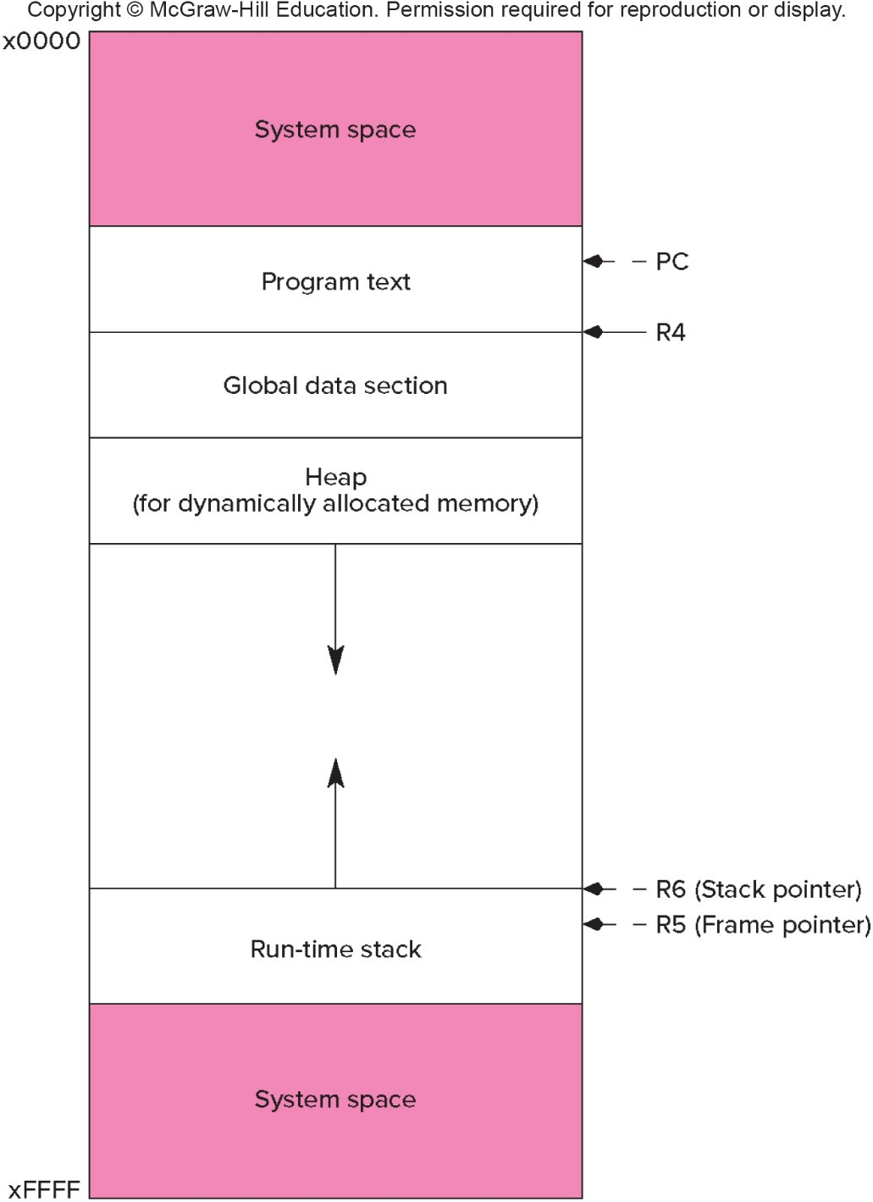
LC-3 Memory Map – The Complete Picture
The LC-3 operating system reserves some of the memory address space for trap vectors, service routine code, and memory-mapped I/O.
Program instructions will be placed in the "program text" section.
Global variables are allocated next. R4 is set to the first allocated address for globals.
Local variables are stored on the run-time stack. R5 points to the local variables of the currently- executing function.

Slide 58
Variables and Memory Locations
In our examples, a variable is always stored in memory.
When assigning to a variable, must store to memory location.
A real compiler would perform code optimizations that try to keep variables allocated in registers.
Why?

Slide 59
Example: Compiling to LC-3
#include <stdio.h> int inGlobal;
main()
{
int inLocal; /* local to main */
int LocalA, LocalB;
/* initialize */
inLocal = 5;
inGlobal = 3;
/* perform calculations */
LocalA = inLocal++;
LocalB = inLocal & ~inGlobal ;
/* print results */
printf("The results are: LocalA = %d, LocalB =%d\n",LocalA, LocalB);
}

Slide 60
Example: Symbol Table
Name | Type | Offset | Scope
inGlobal | int | 0 | global
inLocal | int | 0 | main
LocalA | int | -1 | main
LocalB | int | -2 | main

Slide 61
Example: Code Generation
; main
; initialize variables
AND R0, R0, #0
ADD R0, R0, #5 ; inLocal = 5
STR R0, R5, #0 ; (offset = 0)
AND R0, R0, #0
ADD R0, R0, #3 ; inGlobal = 3
STR R0, R4, #0 ; (offset = 0)
; first statement:
; LocalA = inLocal++;
;address of inLocal = R5 + #0
Address of localA = R5 + # -1
LDR R0, R5, #0 ; get inLocal
ADD R1, R0, #1 ; increment
STR R1, R5, # -1 ; store localA

Slide 62
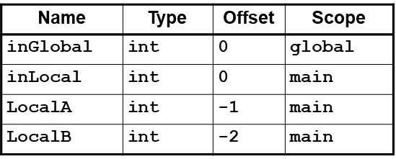
Example (continued)
; second statement:
; LocalB = inLocal & ~inGlobal;
address of inGlobal= R4+ #0
; previous code segment left
; inLocal value in R0
LDR R1, R4, #0 ; get inGlobal
NOT R1, R1 ; Not inGlobal
AND R2, R0, R1 ; inLocal & ~inGlobal
STR R2, R5, #-2 ; store in LocalB
; (offset = -2)

Slide 63
Example: C to LC3 Translation
What is the C code corresponding to these LC3 code segments
Y= A+X;
First identify accesses/addresses for variables A, X, Y:
R4, #0 R5, #0 R5, # -1
Symbol Table:
Identifier | Type Offset Scope
A | int | 0 | Global
B | int | 2 | Global
X | int | 0 | main
Y | int | -1 | main
Z | int | -2 | main

